Slide 1
Customer Segmentation
Omar Alsabbah Data scientist

Slide 2
Introduction
Problem Statement:
We aim to enhance marketing strategy by leveraging data-driven customer segmentation for more efficient targeting and personalized campaigns.
We also aim to increase profit and manage excess inventory in an efficient way.
Inefficient marketing campaigns can be addressed through the utilization of data for precise customer segmentation and tailored messaging.

Slide 3
Data-Driven Approach
Data-driven decision making leverages data to optimize strategies, enhancing precision and relevance in customer segmentation and personalized marketing.
A more targeted approach using data-driven segmentation instead of data eyeballing and gut feelings, enhances customer experience and campaign effectiveness.
Personalized marketing, powered by data insights, leads to enhanced brand loyalty, reduced marketing costs, and competitive advantage in the market.

Slide 4
Methodology
Dataset:
Offer details: Contains details and characteristics of each offer.
Transactions: Contains the customers and the offer they bought each time.

Slide 5
Methodology
K-Means clustering is an unsupervised machine learning method that groups data points into 'k' clusters based on similarities.
K-Means clustering identifies distinct customer segments for targeted marketing campaigns, improving personalization and efficiency.
Creating a new dataset (Customer-offer matrix) which is a combination of the 2 collected datasets to be suitable as an input to the machine learning algorithm keeping all useful information.

Slide 6
The Elbow and Silhouette Methods
The Elbow Method is a technique used to find the optimal number of clusters in K-Means by plotting the within-cluster sum of squares against the number of clusters.
It reflects the level of similarity between points in same cluster.
The Silhouette Method is another effective technique to determine the optimal number of clusters for K-Means. It measures how similar an object is to its own cluster compared to other clusters.
The silhouette score ranges from -1 to +1, where a high value indicates that the object is well matched to its own cluster and poorly matched to neighboring clusters.
Provides a more nuanced view by considering both the cohesion (how close the points in a cluster are) and the separation (how distinct a cluster is from others).

Slide 7
Understanding our segments
Decided the number of clusters to be 3 using the 2 two mentioned methods
This choice represents a good balance between having well-defined, distinct clusters and maintaining a model that is interpretable and manageable clusters for business decisions.
Resulting clusters are (0, 1, 2) and customers are assigned to these clusters.
Cluster 0: 48 customers , Cluster 1: 16 customers, Cluster 2: 36 customers.
Next step is to understand characteristics and preferences of each.

Slide 8
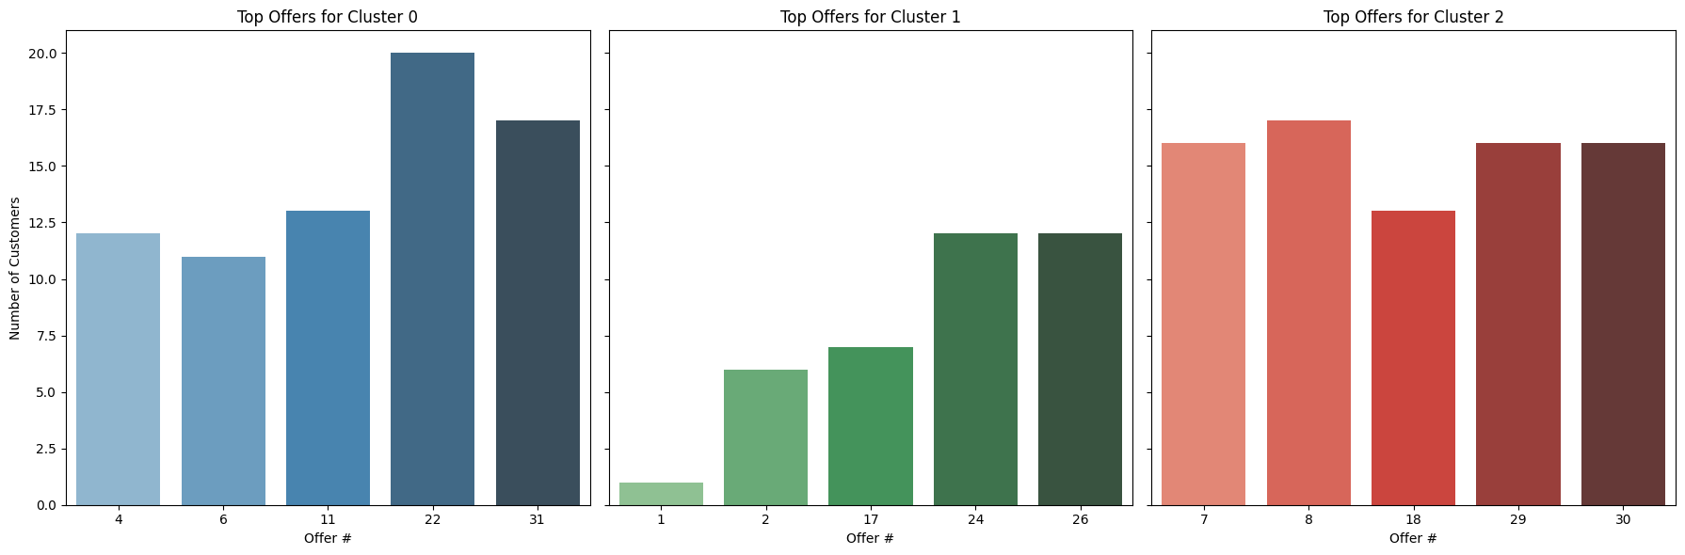
Buying Patterns Analysis
The following visual showcases buying behaviors and trends across distinct customer segments and top selected offers.

Slide 9
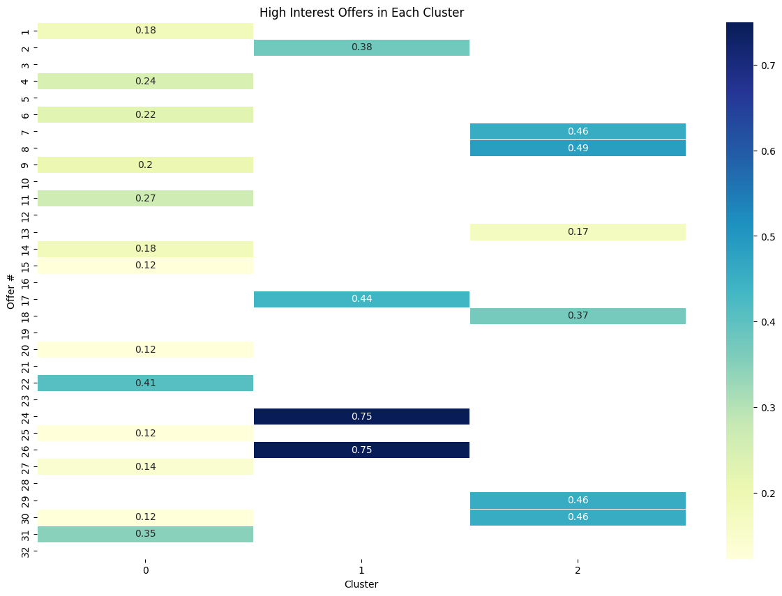
Buying Patterns Analysis
The following visual showcases buying behaviors and trends across distinct customer segments and offers that have response rate above average.

Slide 10
Buying Patterns Analysis
Insights and findings:
Cluster 0: Appears to be moderately engaged with a broad range of offers. Marketing strategies could focus on diversifying the types of wines and offers to this group.
Cluster 1: Seems to be selective but highly interested in certain offers. It would be beneficial to identify the specific attributes of offers that resonate with this cluster and focus on those.
Cluster 2: Shows interest in specific offers, perhaps more than Cluster 0. Identifying and targeting their preferences could lead to higher engagement.

Slide 11
Customer Preferences Analysis
To gain more actionable insights, it would be useful to analyze which specific offers (like varietal, quantity, time, origin, etc.) are most appealing to each cluster.

Slide 12
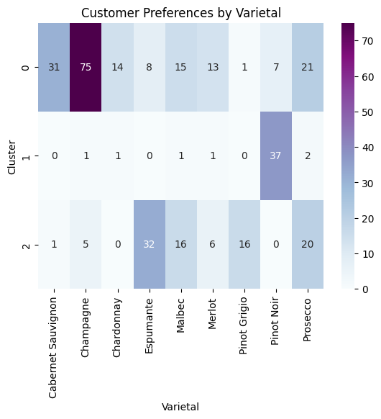
Customer Preferences Analysis

Slide 13
Customer Preferences Analysis
Cluster 0:
Shows a strong preference for Champagne (74 mentions) also shows significant interest in Cabernet Sauvignon (31), Prosecco (21), and Chardonnay (14).
This suggests that Cluster 0 customers are more inclined towards a variety of wines, with a particular preference for Champagne.
Cluster 1:
Dominantly prefers Pinot Noir (37 mentions), with very limited interest in other varietals.
This cluster represents customers with a specific preference, mainly for Pinot Noir.
Cluster 2:
Shows a high preference for Espumante (32 mentions) and Malbec (16), and also a significant interest in Prosecco (20) and Merlot (6).
Customers in this cluster seem to favor wines like Espumante and also show varied preferences in others including Malbec and Prosecco.

Slide 14
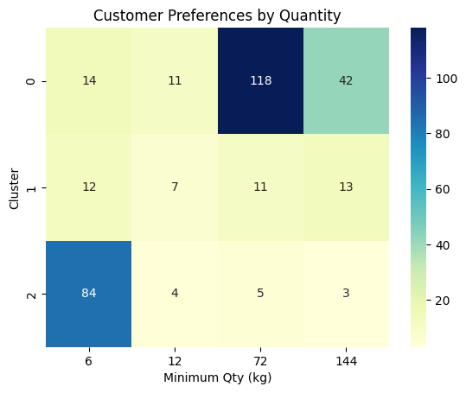
Customer Preferences Analysis
Cluster 0: Shows a preference for larger quantities, with 117 mentions for 72 kg and 42 mentions for 144 kg.
Cluster 1: More balanced across different quantities, but with a slightly higher preference for smaller quantities (6 kg and 12 kg).
Cluster 2: Overwhelmingly prefers the smallest quantity (6 kg), with 85 mentions.

Slide 15
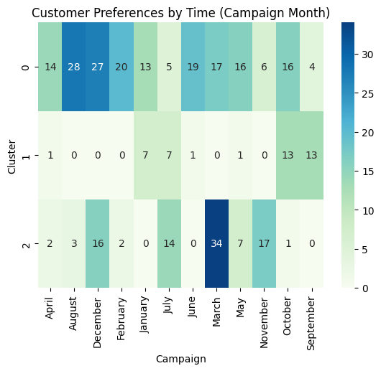
Customer Preferences Analysis
Cluster 0: Active throughout the year, with higher activity in August, December, and October.
Cluster 1: Highly specific preferences, primarily active in January, July, and October.
Cluster 2: Shows a strong preference for campaigns in March and November.

Slide 16
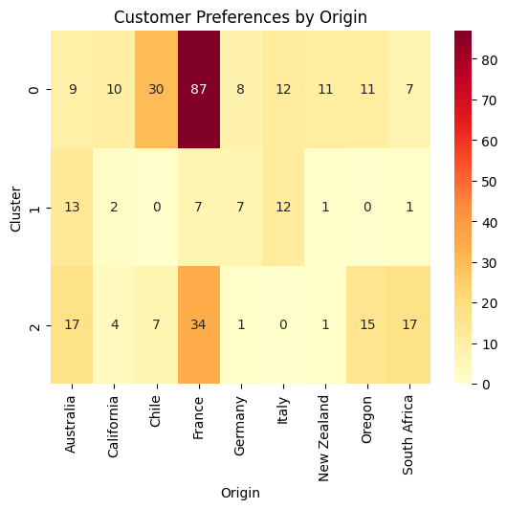
Customer Preferences Analysis
Cluster 0: Strong preference for wines from France (85 mentions), followed by Chile (30 mentions) and Australia (9 mentions).
Cluster 1: Diverse origins, with a preference for Australia (13 mentions) and Italy (12 mentions).
Cluster 2: Prefers wines from Australia (17 mentions), Oregon (15 mentions), and South Africa (17 mentions).

Slide 17
Conclusions and recommendations
Based on the insights and preferences identified for each cluster, here are the end results and strategic actions: Cluster 0: Preferences: Prefer Champagne, Cabernet Sauvignon, and a variety of other wines. Show a preference for larger quantities and are active throughout the year, with peaks in August and December.
Actions:
Inventory Management: Stock up on Champagne and Cabernet Sauvignon, especially before high-activity months.
Marketing Strategies: Launch bulk purchase discounts or loyalty programs targeting this cluster, emphasizing the variety and larger quantities.
Seasonal Campaigns: Plan major marketing campaigns before August and December, keeping in mind the continuous activity in all months.

Slide 18
Conclusions and recommendations
Cluster 1:
Preferences: Show a strong preference for Pinot Noir. These customers prefer smaller quantities and show specific buying patterns, particularly in September and October.
Actions:
Inventory Management: Ensure a steady supply of high-quality Pinot Noir to meet the demand.
Targeted Marketing: Develop marketing campaigns specifically for Pinot Noir, targeted around January, July, September and October.
Personalized Offers: Create personalized offers and events for this cluster to deepen their loyalty and engagement even for other products.

Slide 19
Conclusions and recommendations
Cluster 2:
Preferences: Favor Espumante, Prosecco, Malbec, and wines from less common origins compared to other clusters. They prefer smaller quantities and are particularly active in March and then the end of year in November and December .
Actions:
Inventory Management: Diversify the inventory with a focus on the preferred wines like Espumante and Prosecco and selections from unique origins like Oregon and South Africa.
Marketing: Develop marketing campaigns specifically for Espumante, Prosecco, Malbec, and highlighting wines from unique origins like south Africa
Seasonal campaigns: targeted around March, and the end of the year.

Slide 20
Thank you.
Omar Alsabbah

